Slide 1
New Member/First Time Attendee Orientation
NCDA Virtual Annual Conference
June 16, 2021

Slide 2
Speakers
Vicki Watson
Executive Director
National Community Development Association
vwatson@ncdaonline.org
Marcy Esbjerg
Director
Community Development
Pasco County, FL
NCDA Membership Subcommittee Co-Chair
mesbjerg@pascocountyfl.net

Slide 3
NCDA History - Origins
1968 – Model Cities Program legislation passed by Congress (LBJ’s “War on Poverty”)
1968 – Model Cities Directors’ Association formed
1974 – Community Development Block Grant replaces Model Cities Program
1974 – Association name changed to National Model Cities and Community Directors’ Association
1979 – Association name changed to National Community Development Association
June 2019 – NCDA Celebrates 50 Years
President Gerald Ford signs legislation for CDBG, 1974

Slide 4
NCDA Staff
Primary Staff
Vicki Watson, Executive Director
Heather Johnson, Training Director/Conference Planner
Michael Lightfield, Controller
Jim Welfley, Technology Director
In Addition…
Melissa Pond (City of Quincy, MA), Social Media Manager/Conference A/V/Photographer
In Addition…
Amaya Daniel – intern
Numerous trainers

Slide 5
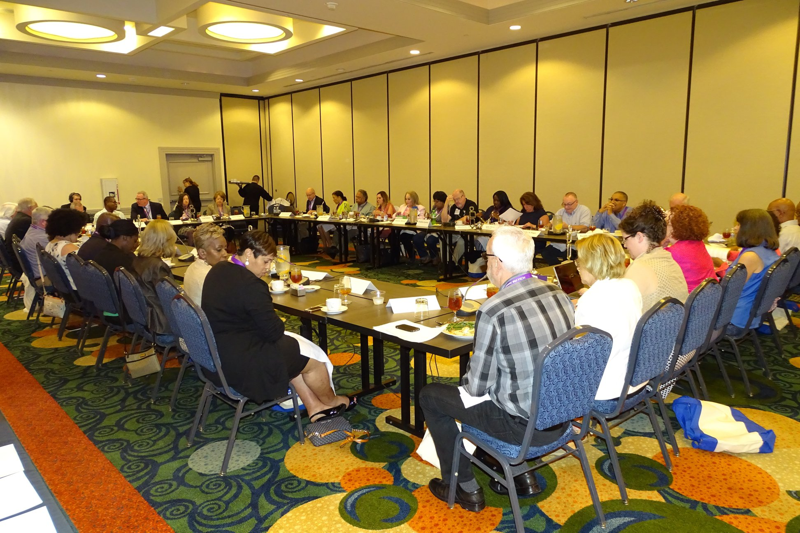
Board of Directors
41 Board Members
All regions represented
OFFICERS
President – Sheryl Kenny, Arlington, TX
Vice-President – Anne Marie Belrose, Boston, MA
Secretary – Vacant
Treasurer – Debra Rhinehart, Seattle, WA

Slide 6
NCDA Regions
Region 1 – New England
Region 2 – New York/ New Jersey
Region 3 – Mid-Atlantic
Region 4 – Southeast/ Caribbean
Region 5 – Midwest
Region 6 – Southwest
Region 7 – Great Plains
Region 8 – Rocky Mountain
Region 9 – Pacific
Region 10 – Northwest

Slide 7
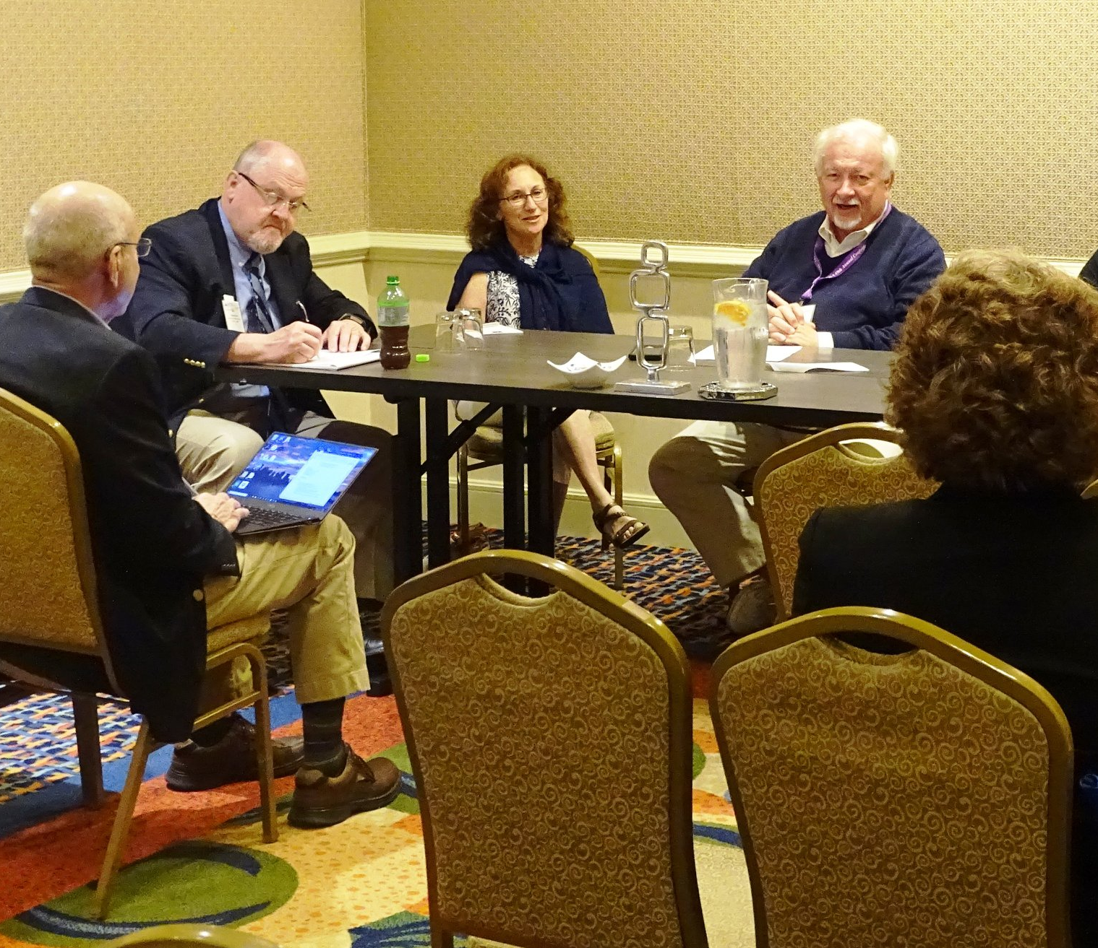
NCDA Subcommittees
Six Subcommittees
• Community Development
• Housing
• Economic Development
• Membership
• Planning and Professional Development
• Technology

Slide 8
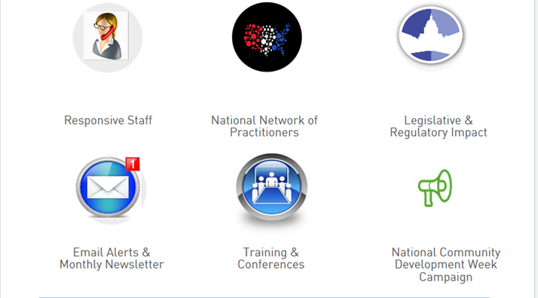
NCDA Membership Benefits

Slide 9
NCDA Member Benefits: Advocacy 2021 Legislative/Regulatory Priorities
Protect/Increase Program Funding
CDBG, HOME, ESG, CoC, Section 108
Reduce Statutory Burden/Increase Program Flexibility
15% set-aside of HOME funds for CHDOs
24-month commitment deadline for HOME funds
Increase HOME admin to 15%
CDBG reforms

Slide 10
NCDA Member Benefits: Advocacy CDBG Coalition

Slide 11
NCDA Member Benefits: Advocacy National Community Development Week
April 5-9, 2021

Slide 12
NCDA Member Benefits: Professional Development / Training
Shirletta Best provides Advanced CDBG Training, June 2018 (Long Beach, CA)

Slide 13
NCDA Member Benefits Professional Development/Training
Online primers
CDBG, HOME, Subrecipient Management, IDIS
Online basics courses
CDBG, Subrecipient Management, IDIS, HOME
Upcoming courses
Con Plan, HOME Underwriting, Financial Management

Slide 14
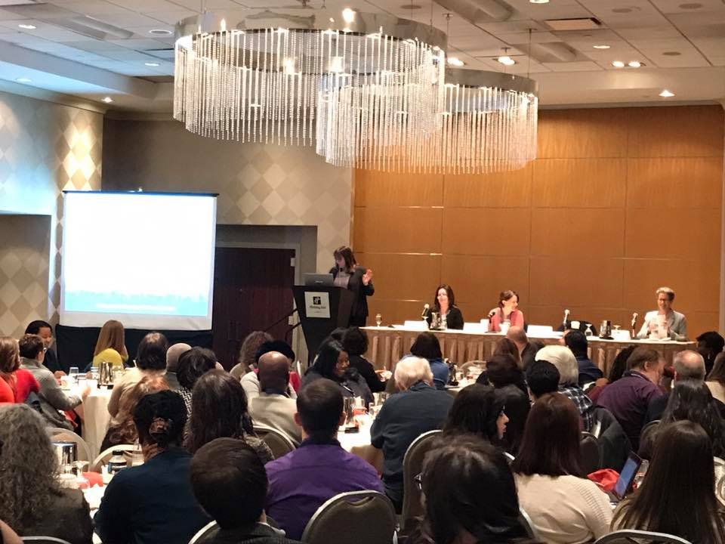
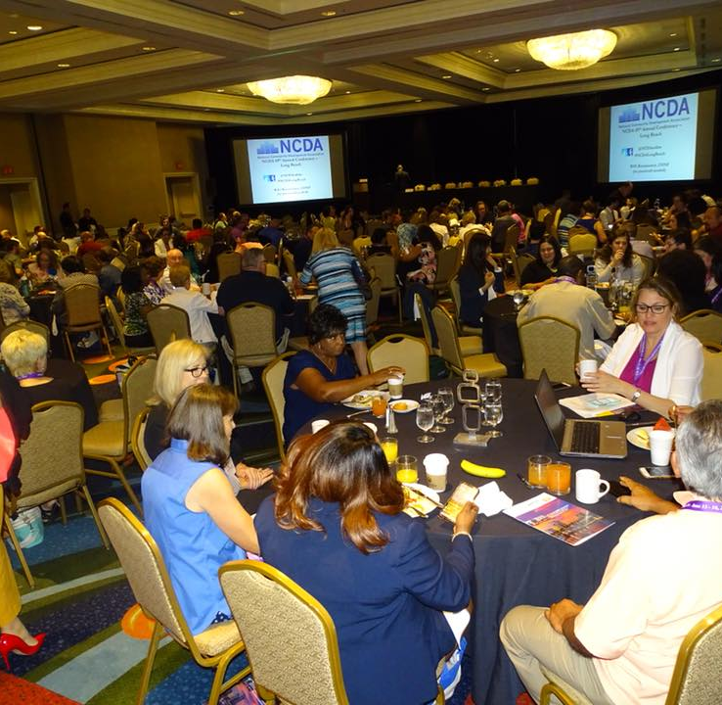
NCDA Member Benefits: Peer Learning Conferences
Winter Conference
Peer best practices
Networking
Hill visits
Annual Conference
Project tours
Peer best practices
Networking

Slide 15
NCDA Member Benefits: Peer Learning NCDA Online Forum

Slide 16
NCDA Member Benefits: NCDA Website Members Only Log-in

Slide 17
NCDA Member Benefits: NCDA Website Jobs Board

Slide 18
NCDA Member Benefits: NCDA Provides You With The Latest Information
Email alerts
Webinars (in the last year)
Eight webinars on CARES Act Funding
Two webinars on community development software
Section 108 webinar
Washington Report Newsletter

Slide 19
We Invite You to Join NCDA
Go to the following link for membership information:
https://ncdaonline.org/membership/
Membership Dues
Based on population
Membership Commitment Form
July 1 – June 30

Slide 20
Questions?

